Slide 1
DIGITAL PORTFOLIO
STUDENT NAME : ranjith kumar p
REGISTER NO : 212402811
NMID : A1D5FE01FBE4811923844B780A6C35D5
DEPARTMENT : BCA
COLLEGE : SRM ARTS AND SCIENCE COLLEGE, CHENGALPATTU
UNIVERSITY : MADRAS UNIVERSITY

Slide 2
PROJECT TITLE
Showcasing Skills, Projects, and Achievements Online

Slide 3
AGENDA
1.Problem Statement – Why this project?
2. Project Overview – What is the project about?
3. Objectives & End Users – Who will use it?
4. Tools and Technologies – What stack used?
5. Portfolio Design & Layout – How it looks (UI/UX)
6. Features and Functionality – What it can do
7. Implementation & Results – Output with screenshots
8. Conclusion – Learnings & future scope
9. GitHub Link / Demo – Source code & live preview

Slide 4
1)PROBLEM STATEMENT
In today’s digital era, students need a strong online presence.
Recruiters expect a single link that shows skills, projects & achievements.
Many resumes don’t demonstrate real work or live demos.
Speak: “Companies scan profiles quickly. Without a portfolio link, our projects, GitHub and achievements stay hidden. So I built a digital portfolio that is easy to view on mobile and share as one link.”

Slide 5
2)PROJECT OVERVIEW
A responsive personal portfolio website.
Sections: Home, About, Skills, Education, Projects, Contact.
Goals: showcase work, share resume, and receive recruiter messages.
Speak:
“This is a static web app hosted online. It highlights my projects with screenshots, GitHub links and a quick contact form

Slide 6
3)Objectives&End users
Objectives (SMART):
Deploy a live site within 2 weeks.
Load under 2s on 4G.
Display ≥5 projects with GitHub links.
Provide easy resume download & contact.
End Users: Recruiters, internship coordinators, hackathon judges, peers.
Speak:
“I measured success by speed, clarity and easy access to projects/resume.”

Slide 7
4)Tools & Technologies
Frontend: HTML5, CSS3, JavaScript (optional: Tailwind/Bootstrap).
Icons: Font Awesome/Material Icons.
Version Control: Git & GitHub.
IDE: VS Code.
Hosting: GitHub Pages (free).
Extras: Google Forms/EmailJS for contact form, Lighthouse for performance.
Speak (justification):
“Plain HTML/CSS/JS keeps it lightweight. GitHub Pages gives free hosting and easy updates.”

Slide 8
5)PORTFOLIO&LAYOUT(UI/UX)
Portfolio Design & Layout (UI/UX)
Dark theme with violet accent; consistent spacing & typography.
Card-based sections with rounded corners.
Navigation: sticky header, section anchors.
Mobile-first grid: 1-column on phones, 2–3 columns on desktop.
Accessibility: alt text, proper headings, good contrast.
Speak:
“I focused on readability: big headings, 60–75 char line length, and clear hierarchy.”

Slide 9
6)Features&Functionality
Responsive layout (mobile → desktop).
Project cards with tech stack, live demo & GitHub buttons.
Resume download (PDF).
Contact form with validation (name, email, message).
Light/Dark toggle (optional).
Social links (GitHub, LinkedIn).
Speak:
“Key feature is quick project discovery. Each card shows role, stack and direct links.”

Slide 10
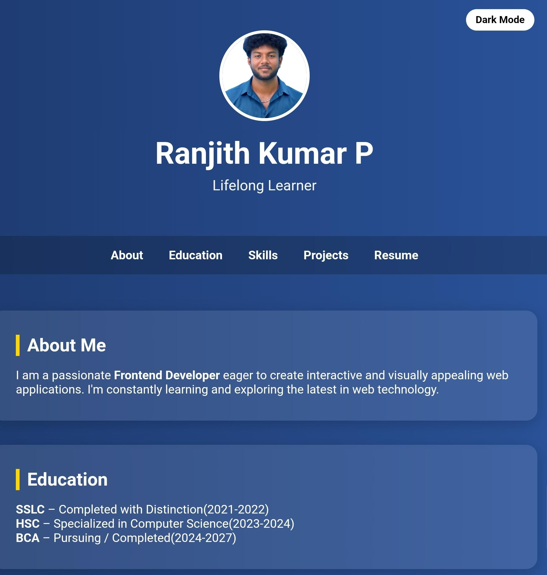
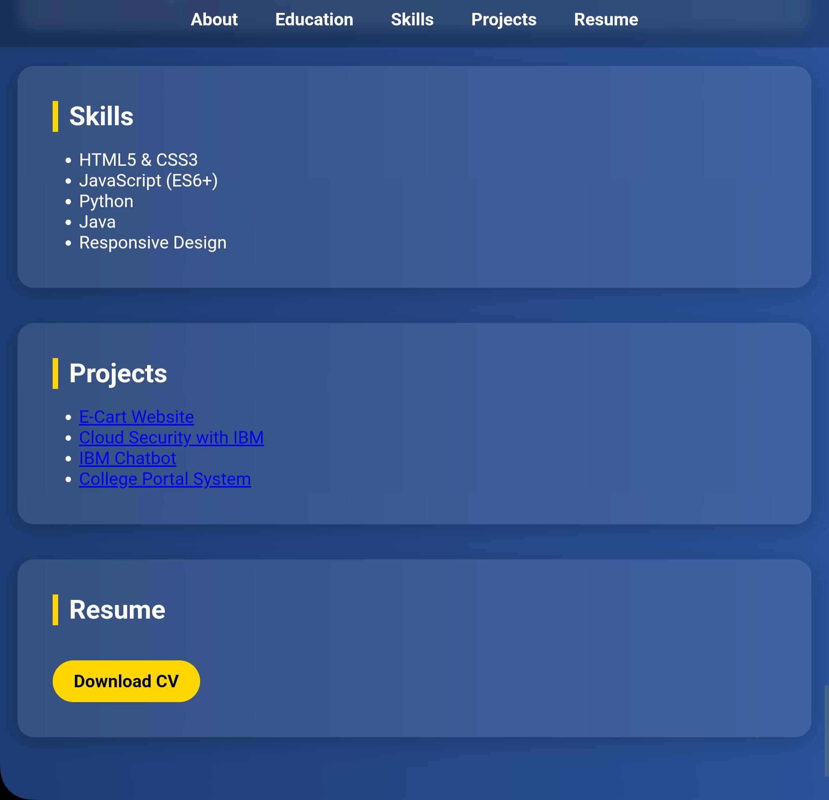
7)Implementation&results

Slide 11
8)CONCLUSION
Learnings: responsive design, Git workflow, performance tuning.
Challenges: image optimization, form handling, consistent design.
Future Work: custom domain, blog section, CMS/React migration, project filters, analytics.
Speak:
“This project becomes my central identity link; I’ll keep adding projects and metrics.”

Slide 12
9)GITHUB LINK
https://ranjithkumar-bca.github.io/nm/

